Slide 1
Scientific programming with C++
Introduction slides
Jere Lavikainen
jere.lavikainen@uef.fi

Slide 2
Course organization and contents
~9 topics over ~8 weeks
Contact sessions on Monday, Tuesday & Thursday 14:15-16:00
Brief theory about each topic
Help available
Voluntary attendance
All mandatory assignments in UEF eLearn (Moodle)
Programming assignments
2 weeks to turn in
First set available on September 4th

Slide 3
Course grading
Points from programming assignments
50% of all points: grade 1
60%: 2
70%: 3
80%: 4
90%: 5
No exam – easy credit points?
Work is in the programming assignments

Slide 4
Course topics
Introduction
Input and output, variables, functions
Objects and classes
Containers and iterators
Reading and writing data
Dynamic memory management and exception handling
Multiple inheritance
Multithreading
Use of 3rd party libraries in research

Slide 5
Course objectives
Programming
“The purpose of the course is that the student will learn the syntax of the C++ language, can design object-oriented programs using the C++ language and are familiar with the C++ standard library.”
Translation: You have the necessary skills and confidence to use C++ and learn more on your own
Scientific
Examples of C++ in academic research
Reading and processing research data
Using APIs of research software
Hands-on programming assignment at the end of the course
You’ll have some idea of how to use C++ for research purposes

Slide 6
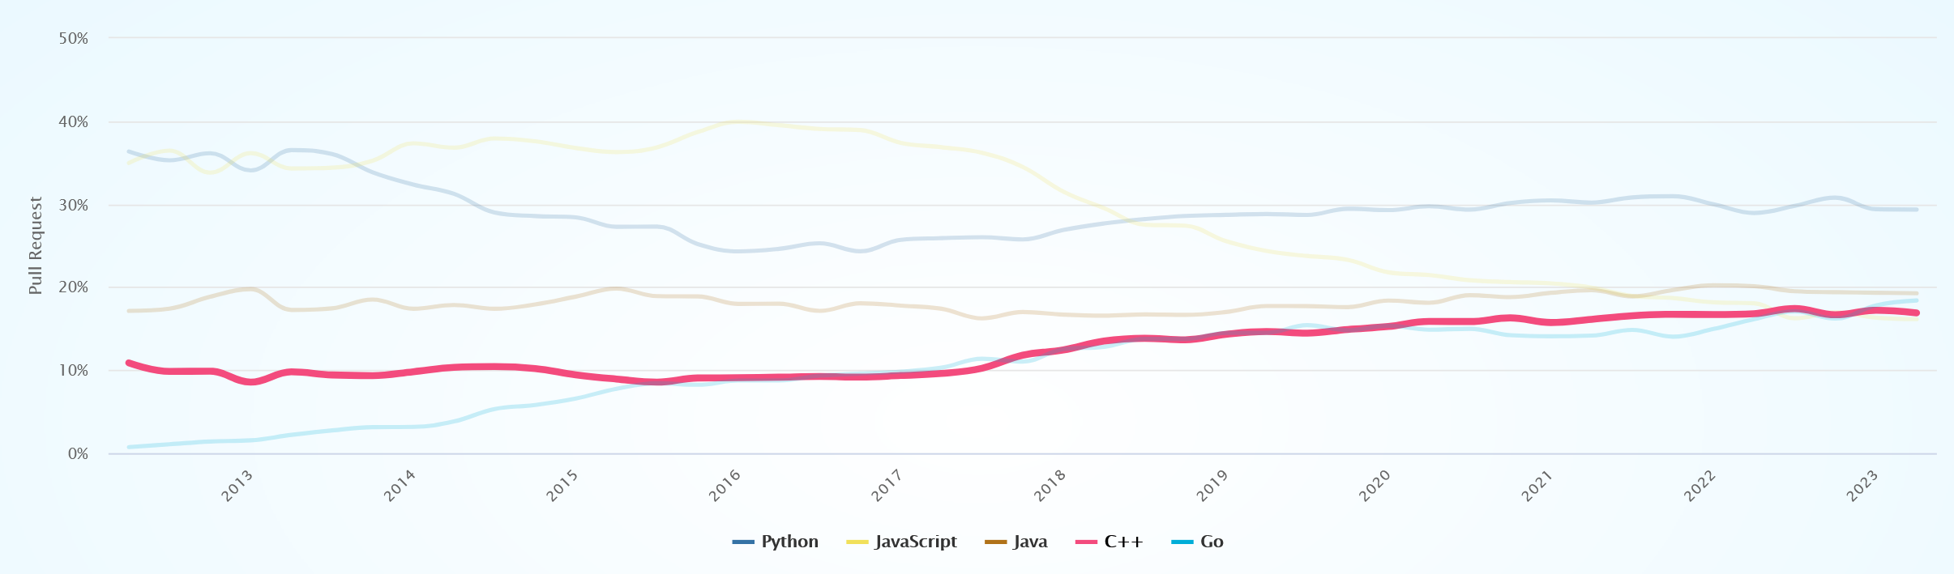
Why C++?
Suitable for high-performance applications
Object-oriented programming and scientific modeling go hand in hand
And so forth (https://www.geeksforgeeks.org/top-10-reasons-to-learn-c-plus-plus/)
Used by millions of people worldwide
https://madnight.github.io/githut/#/pull_requests/2023/2

Slide 7
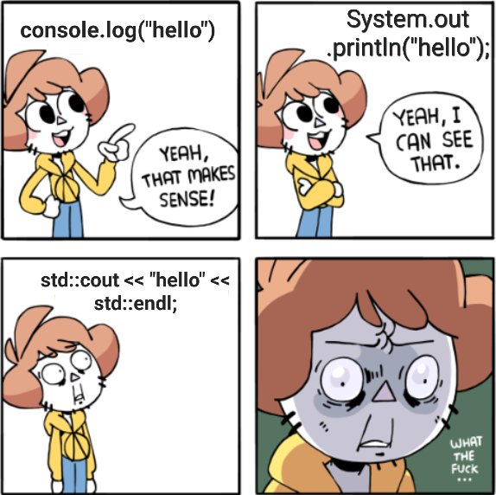
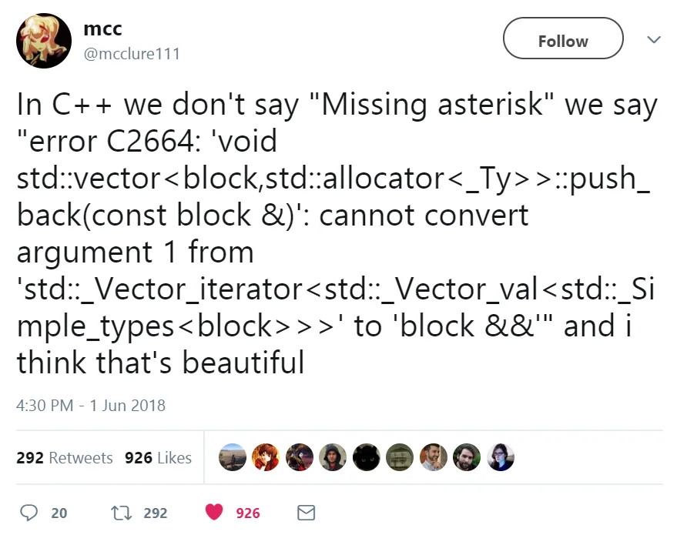
Why not C++?
The syntax is cumbersome
Making very simple programs can be easier on other languages like Python
But in scientific context, you usually don’t make very simple programs
https://www.reddit.com/r/ProgrammerHumor/comments/x8ri80/seriously_wtf_c/
https://www.reddit.com/r/ProgrammerHumor/comments/8nwyma/c_is_a_beautiful_language/

Slide 8
When to use C++ in research?
I need to…
create plots of data I already have
MATLAB/Python
conduct statistical analysis for my research paper
MATLAB/Python
train shallow neural networks for time series prediction
MATLAB/Python (or C++ if I have too much spare time)
extend the API of existing software libraries so I can create my own analysis pipeline
MATLAB/C++/Python
make a program that reads data from measurement devices, processes it immediately and uses the results to control the measurement or provide real-time feedback
C++
The more complex or performance-heavy the task is, the more likely I will use C++ for it
For quick independent tasks that require little customization, I use something else

Slide 9
Some characteristics of C++
Object-oriented
Programming is done by instancing objects from classes, which model systems with different properties, unique behavior, and inheritance
High-/middle-level language
Both written English and more complex statements in syntax
Supports multi-threading
Useful in high-performance applications
Memory management is dynamic but not fully automated
Memory leaks are possible
The programmer has a lot of control over fine details
And a lot of responsibility

Slide 10
Hello world compared with MATLAB and Python
MATLAB
C++
Python
% This is a comment
disp("Hello world")
#include <iostream>
// This is a comment
int main()
{
std::cout << "Hello world";
}
# This is a comment
print('Hello world')

Slide 11
Line-by-line breakdown of “Hello world”
A preprocessor directive to include objects from the iostream header
A comment for the human reader, not compiled in the program.
#include <iostream>
// This is the main program
int main()
{
std::cout << "Hello world";
}
A function begins with its type (int) and name (main). The parentheses enclose its input arguments (in this case none). The “main” function is where all functionality of the program is located (functions that aren’t called directly or indirectly from main are never called) inside the curly brackets.
cout is an object from the iostream library that can be used to print text.
namespace std
Double quotes enclose a string
Semicolon termination
<< operator

Slide 12
Anatomy of C++ code
headers to include
#include <iostream>
#include <string>
#include <Windows.h>
void leftClick()
{
INPUT input;
input.type = INPUT_MOUSE;
input.mi.dx = 0;
input.mi.dy = 0;
input.mi.dwFlags = (MOUSEEVENTF_LEFTDOWN | MOUSEEVENTF_LEFTUP);
input.mi.mouseData = 0;
input.mi.dwExtraInfo = NULL;
input.mi.time = 0;
SendInput(1, &input, sizeof(INPUT));
}
void doStuff()
{
leftClick();
}
int main()
{
doStuff();
}
functions in order of dependency
main() function

Slide 13
C++ basics
camelCase
Operators
Indexing from 0
Loops
If statements and conditions
Blocks
Namespaces
Comments

Slide 14
C++ basics: camelCase
Variables and functions are named using lowerCamelCase
All separate words in the name except the first one start with an uppercase letter
Examples: coordinatePoint, calculateTotalArea, userIdentifier
Classes are named using UpperCamelCase
All words in the name start with an uppercase letter
Examples: Vehicle, KinematicsSolver, DataValueManager
This is not enforced in the language itself, but is a common convention and helps understanding your and others’ code
Other styles exist, for example snake_case
Use a consistent style in your projects, whatever the style is

Slide 15
C++ basics: operators
Characters (usually symbols) that have some defined behaviour for variables
Some (but not all) operators:
Assignment (=)
Assigns a value (right) to a variable (left)
Arithmetic (+, -, *, /, %)
Basic maths
Compound assignments (+=, -=, *=, /=, and so forth)
Modifies the value of a variable (left)
Increment and decrement (++, --)
Increase or decrease the value of a variable by 1
Relational and comparison (==, !=, >, <, >=, <=)
Logical (!, &&, ||)
int a = 1;
int b = 2 * a;
a += 2; // same as a = a+2;
++a; // same as a = a+1;
bool c = (a == b);
bool d = !c;

Slide 16
C++ basics: indexing
The first element of a container or array is at index 0
Elements are usually accessed with square brackets []
Example:
std::string exampleString = “programming”;
exampleString has 11 elements
1st element is ‘p’ and accessed with exampleString[0]
2nd element is ‘r’ and accessed with exampleString[1]
Last element is ‘g’ and accessed with exampleString[10]
Even though exampleString has 11 elements!
std::string exampleString = "programming";

Slide 17
C++ basics: loops
Three types: for loop, while loop, and do-while loop
For loop is an incrementing loop
While loop repeats as long as a defined condition is met
Ideally you will change this condition at some point in the loop to avoid endless looping
Do-while loops repeats as long as a defined condition is met (like while loops) but the loop is executed at least once even if the condition is never met
Loops can be (and often are) nested
Loops within loops
The “break” keyword can be used to exit the innermost loop

Slide 18
C++ basics: for loop
Set the condition for the loop to be: “variable i is smaller than 10”
Define and initialize the looping variable “i” to be an unsigned integer starting from 0
Increment i by one after each loop
for (unsigned int i = 0; i < 10; ++i) {
std::cout << i << std::endl;
}

Slide 19
C++ basics: while loop
Define and initialize a boolean variable as true
bool keepGoing = true;
while (keepGoing) {
keepGoing = checkIfKeepGoing();
}
Create a while loop with the condition “while keepGoing is true”
Update the value of keepGoing from another function

Slide 20
C++ basics: do-while loop
bool keepGoing = true;
do {
keepGoing = checkIfKeepGoing();
} while (keepGoing);

Slide 21
C++ basics: if statements and conditions
Condition: a statement that returns a Boolean value
Note! == is equality operator, = is assignment operator
Note! If a and b are different types, comparison may not work properly
if (condition) {
// implement what to do here
doThings();
}
else if (anotherCondition) {
doStuff();
}
else {
doSomething();
}
a<b
a<=b
a>=b
a>b
a==b
a!=b

Slide 22
C++ basics: blocks
Curly brackets are used to organize C++ code into separate sections called blocks (or compound statements)
Both mandatory (functions, multiline loops and if statements) and voluntary
Can be nested
First block is “level 1”, its inner block is “level 2“ etc
Defines the scope of variables
A variable definition inside a block is not valid in outer blocks, or lower-level blocks
Can be used for a variety of handy tricks like variable shadowing

Slide 23
C++ basics: namespaces
Provides scope and grouping to identifiers such as functions, classes, variables etc
Prevents ambiguity in identifier names
What if you use two different libraries that both have a class “Matrix”?
If the library namespaces are “abc” and “xyz”
Accessed with
The fully qualified name (the safer way)
The “using” declaration (the easier way)
Matrix someMatrix;
abc::Matrix oneMatrix;
xyz::Matrix anotherMatrix;
std::cout << "Hello world";
using namespace std;
cout << "Hello world";

Slide 24
C++ basics: comments
Use comments to explain your code
To others
To yourself
Temporarily disable parts of the code
Single-line comments start with //
Multi-line comments start with /* and end with */
// This is a single-line comment. Anything after the // will be ignored by the compiler. int a = 0;
/* This is a multi-line comment.
Anything between the beginning and the end of the comment will be ignored by the compiler.
int b = 0; */

Slide 25
C++ basics takeaways
camelCase
Use a consistent style
Blocks
Understand variable scope
Namespaces
Avoid mixing up similarly named objects or functions
Group identifiers by libraries
Example: C++ Standard Library (std)
Comments
Explain what your code should do to others and yourself

Slide 26
Surviving the course
Software tools
Visual Studio, VSC, NetBeans, Eclipse, …
Matplot++ or another data visualization library recommended
Online C++ compilers such as https://www.onlinegdb.com/online_c++_compiler
Useful websites
Stack Overflow
W3Schools
Tutorialspoint
GeeksforGeeks
ChatGPT (chat.openai.com)
University has ruled that you must mention when turning in your assignment if you used AI tools

Slide 27
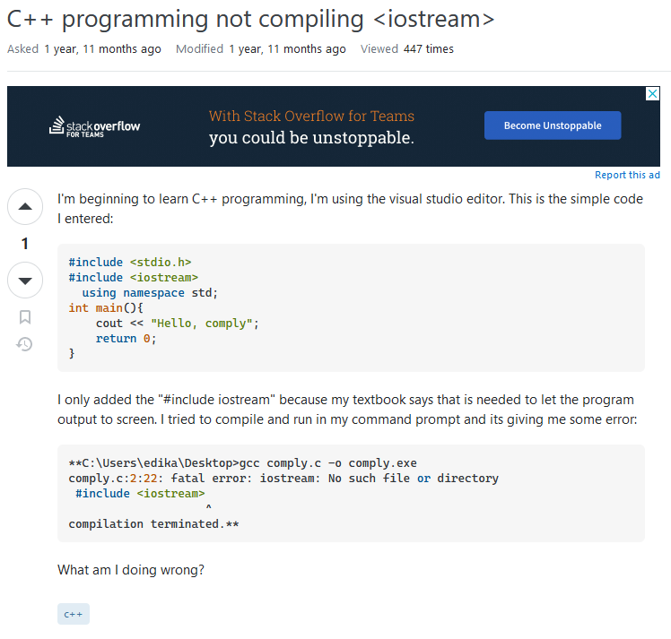
Stack Overflow
Any issues you encounter while writing code have already been asked (and usually answered) by someone else

Slide 28
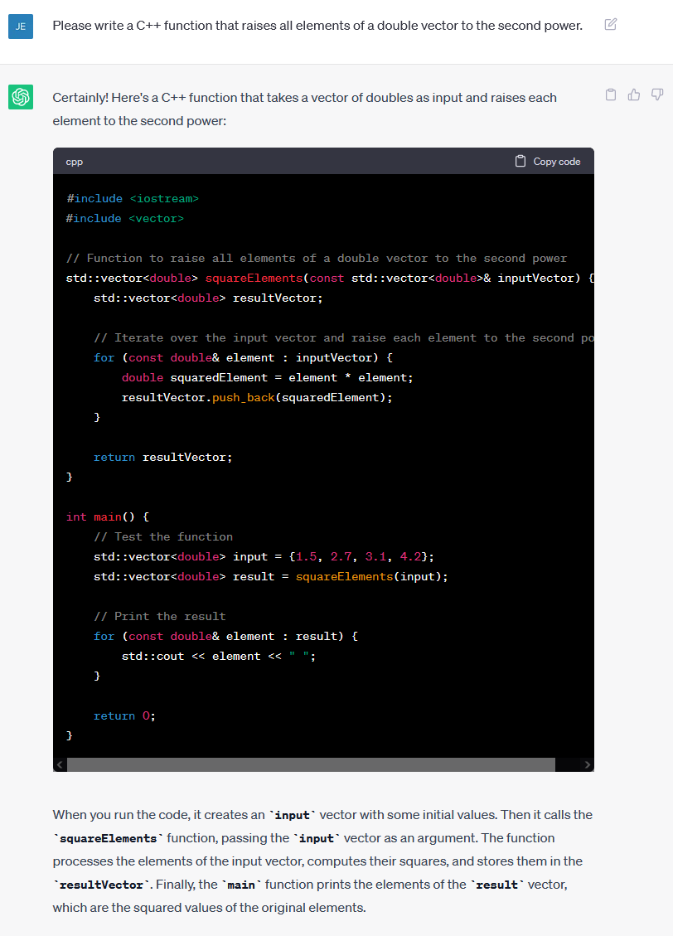
ChatGPT

Slide 29
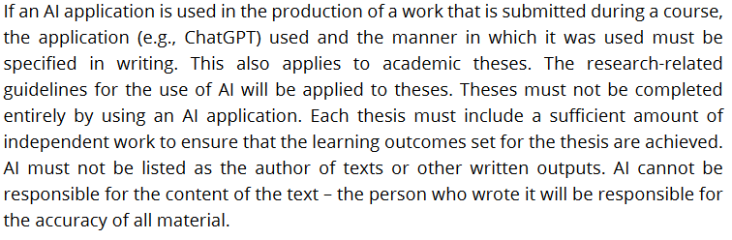
ChatGPT: disclaimer
Guidelines for the use of AI in teaching and research at the University of Eastern Finland (14/6/2023):
Mention how you used ChatGPT when turning in your assignment

Slide 30
Surviving the course
Some prior programming experience is assumed but not strictly required
If you don’t know basic concepts like loops and functions, you may need some extra work to catch up
Sources of information organized from best to worst:
Stack Overflow
Google & programming websites
Lecturer
ChatGPT
Slides are not meant to be exhaustive
You are expected to read more elsewhere
Reserve plenty of time for the programming assignments

Slide 31
Introduction survey
Moodle
Previous programming experience
Expectations and wishes for the course
Lots of answers already
Python is a common background
Some requested topics will be in the course
We may be able to explore some others in the last sessions
Some asked for challenging and interesting assignments
Others hoped they can pass the course

Slide 32
Setting up your C++ environment
Text editor
Preferably with syntax highlighting
Notepad++, Visual Studio Code, …
C++ compiler
Builds computer programs from source code
Integrated development environment (IDE)
Text editor, debugger, compiler
Visual Studio Community

